Slide 1
Computer Graphics Shading
László Szécsi szecsi@iit.bme.hu
AIT

Slide 2


Illusion of the real world
tone
mapping
pixel
virtual world
λ
λ
color
real world
λ
λ
λ
Notes:
In order to compute the image, the power arriving at the eye from the solid angle of each pixel needs to be determined on different wavelengths.
We establish a virtual world model in the computer memory, where the user is represented by a single eye position and the display is represented by a window rectangle. Then we compute the power going through the pixel toward the eye on different wavelengths, which results in a power spectrum.
If we can get the display to emit the same photons, then the illusion of watching the virtual world can be created. As the human eye can be cheated with red, green, and blue colors, it is enough if the display emits light on these wavelengths. The last step of rendering is the conversion of the calculated spectrum to displayable red, green and blue intensities, which is called tone mapping. If we compute the light transfer only on these wavelengths, then this step can be omitted and the resulting spectrum can be used directly to control the monitor.
One crucial question is what exactly should be computed that describes the strength of the light intensity and when the pixel is controlled accordingly, provides the same color perception as the surface. Note that the pixel is at a different distance than the visible surface. The orientations of the display surface and of the visible surface are also different. The total emitted power would definitely be not good since it would mean less photons for the eye for farther sources.

Slide 3
Physical measures of light
radiant power
radiant power density
exitance
irradiance
radiant intensity
radiance
sidenote: lumen, lux, and candela are just power, power density, and intensity, respectively, of every wavelength weighted by human brighness perception of that wavelength
Notes:
Light is electromagnetic radiation in the range of visible wavelengths. We need to turn to physics, and to radiometry in particular, to find out what measures of light can be used to express the quantities we are interested in.
Here listed are the phrases we need to use to talk about light in pedantic terms. Admittedly, you can get quite far in computer graphics without having a clear idea about how these are different from each other, by just using the quite simple formulae we will eventually arrive at, or even just trusting OpenGL to apply them correctly for you. However, if we wish to understand what we are doing, we have to start here. Let us review them one by one.

Slide 4

Watt [ W ]
~ photons crossing per second
Notes:
A well-known measure of light is wattage, or power. A light bulb is characterized by its electrical power uptake, given in watts. Admittedly, much of that wattage goes to heating the bulb, but some of it is converted to light.
We can imagine light as lots of identical photons travelling along straight lines --- wave properties of light need not be considered for 3D rendering, and the fact that real photons have different wavelengths we can address later, when we already have a system for uniform-wavelength photons, i.e. monochromatic light.
Every photon carries the same amount of energy. The power is therefore propertional to the number of photons leaving the bulb., or, more accuratelty put, the number of photons crossing the surface of the bulb. In a similar manner, we can talk about the power of light arriving at a wall (or the surface of any object). We can talk about the power of light reflected from the same wall. We can talk about the power flowing through any surface. For that reason, radiant power is also called radiant flux.
This, of course, does not directly tell us what a piece of surface appears like. Power can be distributed on the surface arbitrarily, and the same can be said for the directions: there might be more photons crossing at some directions than others.

Slide 5
Measures and units of light
radiometry single wavelength (or three) | photometry weighting wavelengths for observer
Measure | Unit | Measure | Unit
radiant power, radiant flux | W watt | luminous flux | lm lumen

Slide 6
Watt per square meter [ Wm⁻² ]
Notes:
It is a straightforward improvement to measure the power emitted per unit area instead of the total power. This removes the total surface area of the emitter from the measure. We get a density-like measure, which is often called power density. As we are talking about photons leaving a surface, the term radiant exitance is the proper one. Of course, emission might be not homogenous over the surface, making this measure a function of position x. The symbol for radiant exitance is M, and the SI unit is Watts over square meters.
Is this measure telling us how bright some surface point appears to be? It tells us how densely photons are emitted from around the point, but not if they are emitted towards our eye.

Slide 7
Watt per square meter [ Wm⁻² ]
Notes:
If we are referring to the density of photons incident on a surface, then we call the same measure irradiance. The symbol is E, and the unit is of course the same. Giving these different names and symbols is quite useful for clarity, as the power density arriving at a surface is of course typically not the same as the power density leaving a surface.

Slide 8
Measures and units of light
radiometry single wavelength (or three) | photometry weighting wavelengths for observer
Measure | Unit | Measure | Unit
radiant power, radiant flux | W watt | luminous flux | lm lumen
r. power density, radiosity, r. exitance, irradiance | W/m² | l. emittance, illuminance | lx lux

Slide 9

Han shot first
Notes:
Let us measure the irradiance of Captain Solo’s laser beam as its pierces through the table board and as it hits Greedo’s vest. We are going to assume piercing that hollow barrel of a table did little enough to the power of the ray so that can be neglected.

Slide 10
Counting photons through unit area
Greedo’s chest
10
20
25
15
5
0
40
30
35
45
27
Table surface
Notes:
We model the blaster beam as a coherent, unidirectional beam of photons. Let us count the number of photons crossing a unit area of both the table surface and Greedo’s surface, for the same duration of time. The blaster pierces the table at an angle, so its power is distributed on a larger area (5 units here), whereas it hits Greedo quite directly, over 3 units of area.
Counting the photons we see that the irradiance on the two surfaces is not the same at all, even though it is the same beam of photons and the “density of light” has of course not changed. This is because irradiance is defined over unit surface, and the surfaces are not the same. Their orientation matters. Thus, we cannot talk about irradiance at a point in space without specifying a surface orientation there. When a well-defined direction is known – as is the case with a coherent blaster beam or when the source of light is very distant – it is natural to take a perpendicular surface to express power density, but this does not just go without saying.

Slide 11


How to characterize how strongly a radio transmitter sends in a certain direction?
Power density depends on distance from antenna
We are interested in power distribution over directions
?
?
Notes:
Although it is tempting to use the word ‘intensity’ as synonymous to any measure of light, the term is actually taken and has well-defined meaning. It is somewhat less prevalent in computer graphics, but it is a very basic measure in radiofrequency technology.
An important property of a radio transmitter antenna is in which directions it emits more radiation. Imagine a GPS transmitter on the roof of your home: you might be comforted to know that the downward radiation is practically zero.
Measuring the power density at some point is meaningful of course, but it does not characterize the transmitter itself. The further you measure, the less the power density is going to be, as power is distributed over a larger area. At double the distance, the area grows double in both dimensions, diminishing power density by a factor of four – this is the inverse square law.
Thus, what RF engineers are interested in when characterizing the antenna is not the distribution of power over surface, but distribution of power over directions. The measure called radiant intensity is thus going to be a function of direction ω. But how do we express directions in 3D, and what is the analogue to what was the area of a surface, and what units is it measured in?

Slide 12
The directional domain
2D
3D
θ
ω∈Ω
ϕ∈[0,2π]
ϕ
directions correspond to points on unit circle
directions correspond to points of unit sphere
Notes:
Everyone is familiar with directions and the measure of direction sets in 2D. Directions correspond to points on the unit circle. A direction can always be given as an angle from the reference direction. In 3D, we need three reference directions, and both the polar and azimuthal angles. Directions correspond to points on the unit sphere. Of course, directions can be represented by the position vectors of the points, i.e. unit-length vectors.
A direction could either be represented by a vector or the two angles, but it is a geometrical entity on its own right, and of course it admits itself to different operations than a vector. Thus, we usually just use the symbol ω for a direction – and only write a direction as a vector when sets of directions are no longer involved. The symbol Ω is used for the complete set of directions.

Slide 13
Measure of planar/solid angles
2D
3D
radian [rad]
arc length on unit circle
complete domain: 2π
steradian [sr]
subtended area on unit sphere
complete domain: 4π
Notes:
In 2D, a contiguous set of directions makes an angle. The measure of that angle is the length of the arc subtended on the unit circle. This measure also has an SI unit, the radian, even though it is dimensionless. We all know that the measure of the complete domain is 2π.
In 3D, a contiguous set of directions -- called a solid angle -- makes some kind of shape on the surface of the unit sphere. The measure of the solid angle is the area of this shape. The dimensionless SI unit is called the steradian. You may be uncomfortable with the fact that we do not specify the shape of the solid angle in any way. You should not be. Just as the pint is a perfect measure of volume without a relation to a measure of lower dimension or having an established shape, so is the steradian perfect for measuring solid angles. Just as we can talk about the number of bubbles per pint, we can also talk about the number of photons per steradian. Or watts per steradian, of course.

Slide 14

Watt per steradian [ W(sr)⁻¹ ]
Notes:
Radiant intensity has the unit of watts per steradian. It is a density-like measure, but instead of distribution over area, it measures distribution over directions. The symbol is I, and intensity is a function of direction ω.
It we split the directional domain into small solid angles, and count the number of photons exiting in them, we can plot radiant intensity. With infinitely small solid angles, the get a function with a continuous domain..
Now, is radiant intensity the measure we are looking for? Does it characterize the appearance of a surface point? Well, it seems to work for the radio transmitter or the light bulb, but only if those are so small they can be considered point-like. If we consider an extended surface, knowing the overall directional distribution of photons is not enough, as light emitted from different surface points in the same direction will travel different paths.
To be able to tell what light hits our eye, we need a measure that takes both directional and area distribution into account.

Slide 15
Measures and units of light
radiometry single wavelength (or three) | photometry weighting wavelengths for observer
Measure | Unit | Measure | Unit
radiant power, radiant flux | W watt | luminous flux | lm lumen
r. power density, radiosity, r. exitance, irradiance | W/m² | l. emittance, illuminance | lx lux
r. intensity | W/sr | l. intensity | cd candela

Slide 16


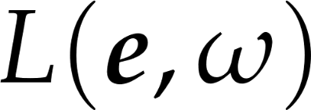
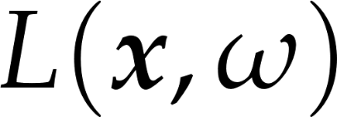
Density with respect to both position and direction
Can express how much light is travelling at
a certain point of space
in a certain direction
eye
=
surface point
Notes:
This measure is radiance. This is absolutely the most important measure in computer graphics, and when less educated graphics programmers talk about light intensity, they most often should say radiance instead.
Radiance is density of radiant power with respect to both position and direction. We are going to examine it more rigorously, but let us first consider intuitively what it can express and why it is a good measure for us.
Radiance is a function of both position and direction. Although we have been talking and will continue to talk in terms of surfaces, radiance can be interpreted at any point in space (if there is no surface there, just image we put one there). Thus, our complete virtual world can be imagined as a continuous, five-dimensional (3D for position, +2D for directions) radiance field. Of course we will only be interested in the radiance at certain points and directions, but the field is still there.
Now consider two points in space, and their radiances along the line that connects them. We know that light travels along straight lines. So what is the relation between the radiance at those two points? If there is no object in between to block the light, no medium that scatters the light, and no interfering light source that adds more radiance, the flock of photons travelling along one arrow will be the same as the photons travelling at the other. Radiance will not change along rays of light.
Now imagine at one point is our eye, and at the other a surface point. If we manage to find the radiance exiting the surface toward the eye, than we have also managed to find the radiance arriving at the eye from that given direction.
Let us look at the proper definition of radiance, and see that the above properties indeed are true and radiance can be used to characterize the appearance of surface points.

Slide 17
Measures and units of light
radiometry single wavelength (or three) | photometry weighting wavelengths for observer
Measure | Unit | Measure | Unit
radiant power, radiant flux | W watt | luminous flux | lm lumen
r. power density, radiosity, r. exitance, irradiance | W/m² | l. emittance, illuminance | lx lux
r. intensity | W/sr | l. intensity | cd candela
radiance | W/srm² | luminance | cd/m² nit

Slide 18
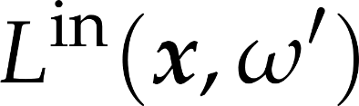
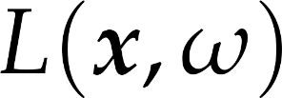



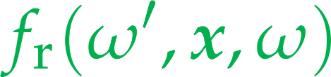

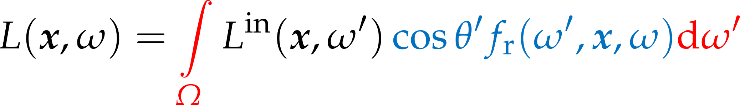
The rendering equation
Notes:
The Holy Grail of computer graphics is the rendering equation. This expresses how much light a certain surface point reflects into a certain direction, i.e. what color a surface appears under given lighting conditions.
Although the rendering equation is a formidable-looking integral equation with term yet unexplained, its meaning can be put in words quite simply. Also, after simplifying assumpltions andwith simple lighting and material models, the rendering equation will turn in pretty simple and swiftly computable formulas.
The rendering equation expressed the outgoing radiance L towards direction ω from shaded surface point x, as the radiance incoming from all directions, times the probability it is reflected towards the outgoing direction.
The factor cosθ’ f_{r}(ω’, x, ω) expresses the probability density of a photon incoming from ω’ refected towards ω. We will examine it further in the following slides.
In the real world, in most situations, some radiance is going to be incoming from all directions, reflected from the surrounding surfaces. However, actually computing this integral (an approach called global illumination) would lead to immense computational costs and very slow, if realistic, rendering. Thus, we consider a simpler theoretical case: when all light is incoming from a single direction.

Slide 19
Special cases
light only comes from one direction
ideal, smooth surface
there is only one incoming direction from where light can be reflected to a given outgoing direction
there is only one incoming direction from where light can be refracted to a given outgoing direction
in these two cases, no integral is needed!

Slide 20
Single light direction
special case – important for local illumination both in ray tracing and OpenGL shading

Slide 21


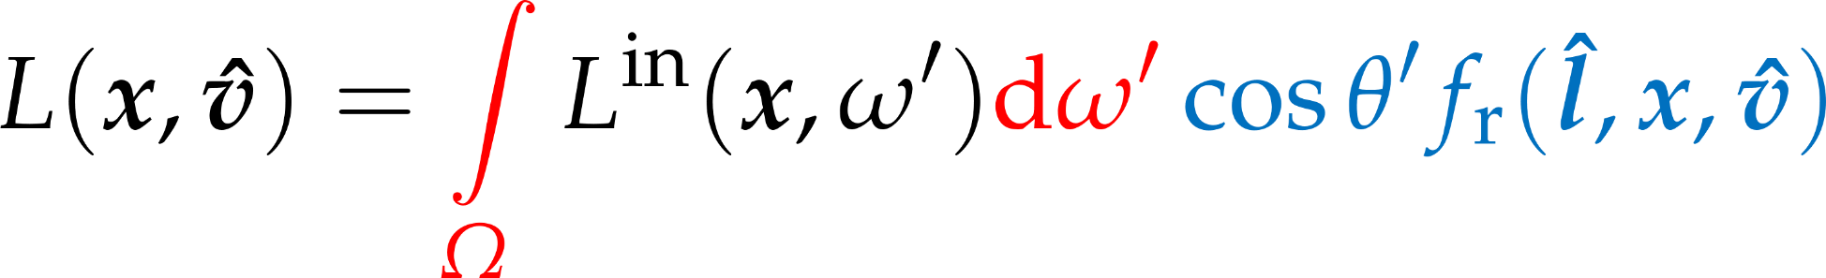
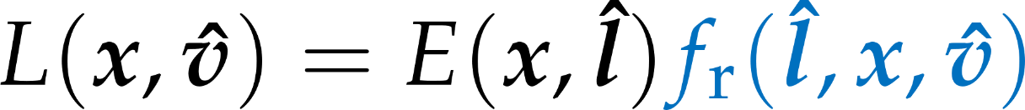
Single light direction case
power density
irradiance
Notes:
If all light is incoming from a single direction, the incoming radiance function has zero value for every direction but the light direction l. At the same time, we want the total incoming power per unit area be something finite. All this finite power density is concentrated on a zero-size solid angle, making the incoming radiance from l infinite. Thus, the radiance is a Dirac-delta function.
The reflection probability factor is now only required for incoming light direction l, as for all other directions, it is multiplied by zero incoming radiance. The factor now devoid of the integration variable ω’ can be moved out of the integral. What remains is the directional integral of the radiance, which is the power density of the incoming light, on a surface perpendicular to the light direction.
Now we can start to explain why we separated the reflection probability factor into a cosine factor and the rest. The cosine of the incoming light angle gives the ratio of the perpendicular surface area over the actual surface area . Multiplying the power density with this cosine factor, we get the irradiance on the surface.
The factor f_{r}(l, x, ω) therefore must express the outgoing radiance as a function of incoming irradiance., which depends on the optical properties (i.e. the material) of the surface.

Slide 22


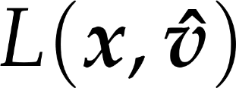
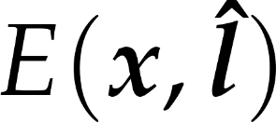

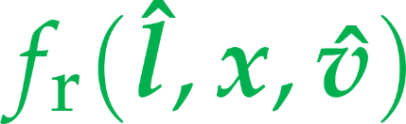

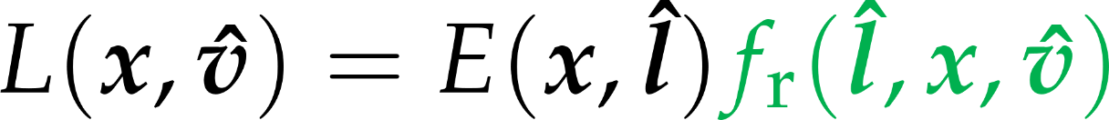
Eye-directional radiance due to single-direction irradiance
eye-directional radiance is
irradiance from light direction times
the probability density of being reflected to view direction
Notes:
In the previous slide, we have already taken the liberty of denoting directions with unit length vectors, namely light direction l is a unit length vector. As we no longer have to deal with integration over directions, the distinction between directions and unit vectors becomes irrelevant, and we can write all our quantities as functions of vectors instead of directions.
The concrete case of reflection that is of interest to us is when we wish to compute the eye-directional radiance of a surface point visible in a pixel. The view direction we denote by unit vector v, the light direction with unit vector l, the surface point is at x. If the incoming irradiance in known, the eye-directional radiance can be computed with this formula. Now it is time to reveal what Fr is.

Slide 23


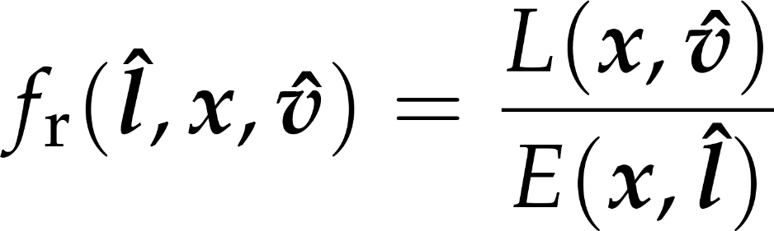
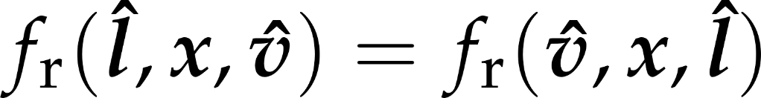
Bidirectional Reflectance Distribution Function - BRDF
the ratio of reflected radiance exiting along to the irradiance incident on the surface from at surface point
this describes the optical behavior of a surface
Helmholz law
[ (sr)⁻¹ ]
Notes:
Fr is the BRDF, or bidirectional reflectance distribution function. It expresses the outgoing reflected radiance in a certain direction in response to unit irradiance from a certain incoming direction. The BRDF can of course also depend on the surface point: not only materials or colors may be different at different surface points, but also the surface may have different orientation, meaning that the same incoming and outgoing directions might be very different with respect to the surface.
The BRDF is a physical property of surfaces. It should obey certain laws of physics. Energy conservation is one such law: a surface should not reflect more light than incident on it. Another is Helmholz’s law: the BRDF is symmetrical, the incoming and outgoing directions interchanges should result in the same reflectance value.

Slide 24
Abstract light source model: directional light
lightPosition
∞
powerDensity
lightDir
light source defined by
light direction, given as an ideal homogeneous position
lights[i].position
:= vec4(unit-length direction towards light, 0)
power density, any positive value, given at RGB wavelengths
lights[i].powerDensity := vec3(red, green, blue)
everywhere, at any shaded surface point
the same vec3 lightDir = normalize(lights[i].position.xyz)
the same vec3 powerDensity = lights[i].powerDensity
Notes:
In case of directional light sources, the radiance is constant everywhere, so is the illumination direction. Thus, the data required for shading is directly given, and there is no need for computation.
The Sun is an example for directional light source if we are on the Earth.

Slide 25

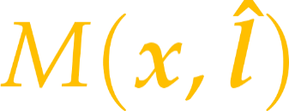
Shading a surface point
light source model
material model
Notes:
This is the algorithm for shading a surface point. The geometric properties position and normal should be available in world space [these are computed from vertex attributes in a GPU shader realization]. Eye positions should be available in world space [a uniform]. Light source data should be available [uniforms], from which the light direction and incoming power density can be computed. Material parameters for the evaluation of the BRDF should be available [uniforms, or from texture].

Slide 26



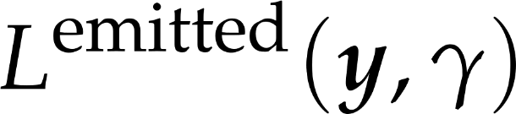
Real light sources
not a single incoming direction
would have to do the integration
Notes:
Real light sources are defined by their emission radiance, L^{emitted}. When the reflected radiance of a point is considered, the contribution of all those light source points should be added which are visible from the point of interest. This means integration. Thus, we often prefer abstract light source models, that can illuminate a surface just from a single direction, which saves integration.

Slide 27
Simple shading in FS
!
vec3 lightDir = normalize(vec3(1, 1, 1));
float cosa = clamp(
dot(lightDir, normal),
0.0,
1.0);
define a light direction vector
points from surface towards light
can be hardwired as a constant
you may replace with a uniform later to animate lighting direction
compute cosine of angle between normal and light
use the dot function
what if the cosine is negative?
return texture color multiplied by this cosine
take care to only scale the RGB, and leave alpha intact (dark should not mean transparent)

Slide 28
Light data in uniforms
.
new uniforms in FS and matching class in JS:
import vision.gears.webglmath.UniformProvider
import vision.gears.webglmath.Vec3
import vision.gears.webglmath.Vec4
class Light(id : Int, vararg programs : Program) : UniformProvider("lights[$id]") {
val position by Vec4(0.0f, 1.0f, 0.0f, 0.0f)
val powerDensity by Vec3(0.0f, 0.0f, 0.0f)
init{
addComponentsAndGatherUniforms(*programs)
}
}
uniform struct {
vec4 position;
vec3 powerDensity;
} lights[8];
responsible for this array element

Slide 29
Setting up a light in Scene
.
responsible for this array element
in the constructor
in update
val lights = Array<Light>(1) { Light(it, *Program.all) }
init{
lights[0].position.set(1.0f, 1.0f, 1.0f, 0.0f).normalize()
lights[0].powerDensity.set(1.0f, 1.0f, 0.0f)
}
can do this max. 8 times
make sure light direction is unit length
gameObjects.forEach { it.draw( camera, *lights ) }
make sure uniforms are provided

Slide 30
Multiple, colored lights
!
vec3 shade(
vec3 normal, vec3 lightDir,
vec3 powerDensity, vec3 materialColor) {
float cosa =
clamp( dot(lightDir, normal),0.0,1.0);
return
powerDensity * materialColor * cosa;
}
set up two or more light sources
different directions
different power density spectra
in FS, write a for loop, adding contributions of light sources to the fragment color
vec3 lightDir = lights[i].position.xyz;
vec3 powerDensity = lights[i].powerDensity;
fragmentColor.rgb += shade(normal, lightDir,
powerDensity,
texture(material.colorTexture, tex.xy/tex.w).rgb);
reflection model
light source model

Slide 31
Expected result
textured model with lighting
but now you can set light direction and power density from Kotlin

Slide 32
Abstract light source model: point light
position
worldPos
lightDir
Notes:
For point light sources, the illumination direction points from the location of the source to the illuminated point. The power density decreases with the square of the distance, as with the photons travelling further, the same power is distributed over a spherical wave front of larger surface area.

Slide 33
Abstract light source model: point light
powerDensity
at unit distance
position
light source defined by
light position, given as a non-ideal homogeneous position
lights[i].position
:= vec4(Cartesian position, 1)
power density at unit distance, any positive value, given at RGB wavelengths
lights[i].powerDensity := vec3(red, green, blue)
at a shaded surface point worldPos.xyz
vec3 lightDiff = lights[i].position.xyz – worldPos.xyz;
vec3 lightDir = normalize(lightDiff);
vec3 powerDensity = lights[i].powerDensity / length²(lightDiff)
worldPos
lightDir
Notes:
For point light sources, the illumination direction points from the location of the source to the illuminated point. The power density decreases with the square of the distance, as with the photons travelling further, the same power is distributed over a spherical wave front of larger surface area.

Slide 34
Point lights – without breaking directional lights
!
// directional case, with lights[i].position.w == 0
vec3 lightDiff =
lights[i].position.xyz // lightDir
– worldPos.xyz * lights[i].position.w;
vec3 lightDir = normalize(lightDiff); // lightDir
float distanceSquared = dot(lightDiff, lightDiff); // 1
vec3 powerDensity =
lights[i].powerDensity
/ distanceSquared;
function shade does not change
reflection model is the same
vec3 lightDiff =
lights[i].position.xyz
– worldPos.xyz * lights[i].position.w;
vec3 lightDir = normalize(lightDiff);
float distanceSquared = dot(lightDiff, lightDiff);
vec3 powerDensity =
lights[i].powerDensity
/ distanceSquared;
// point case, with lights[i].position.w == 1
vec3 lightDiff =
lights[i].position.xyz
– worldPos.xyz * lights[i].position.w;
vec3 lightDir = normalize(lightDiff);
float distanceSquared = dot(lightDiff, lightDiff);
vec3 powerDensity =
lights[i].powerDensity
/ distanceSquared;

Slide 35
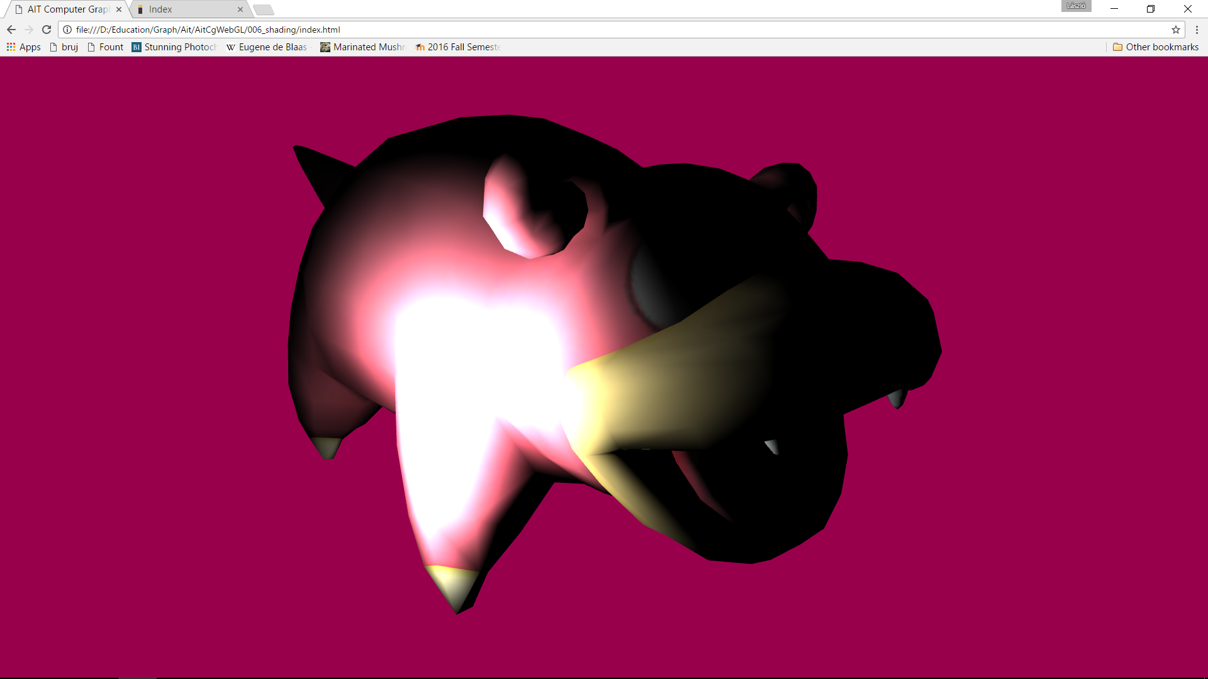
Task
!
make the point light orbit the object

Slide 36

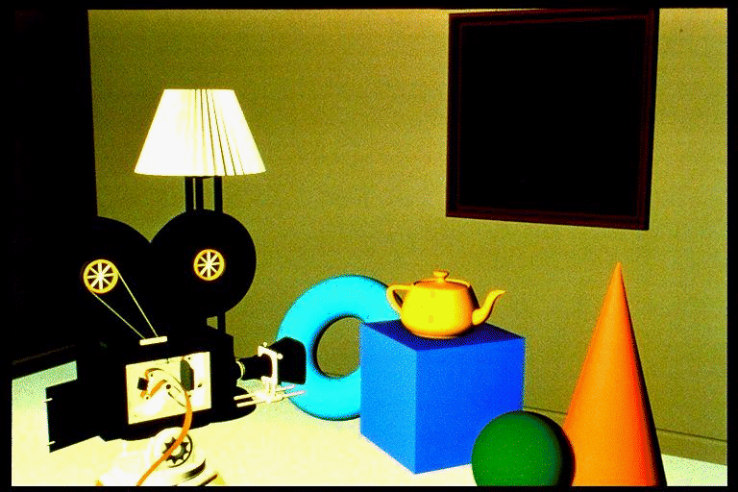
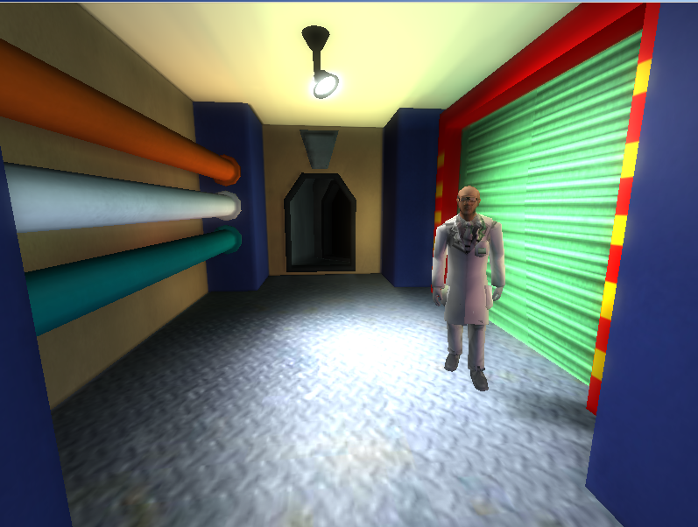
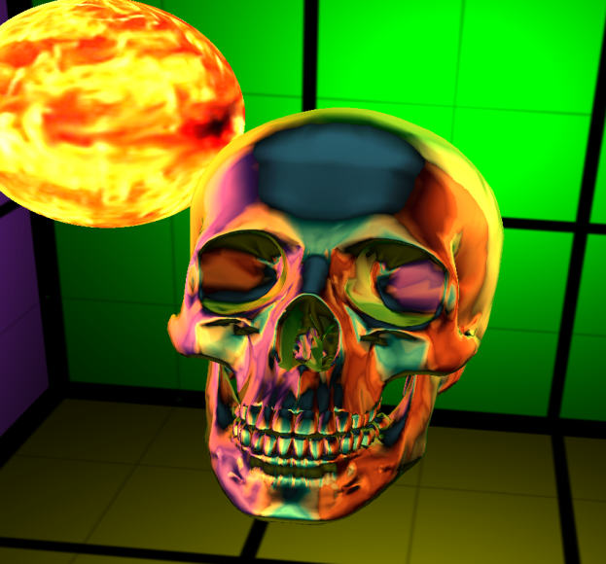
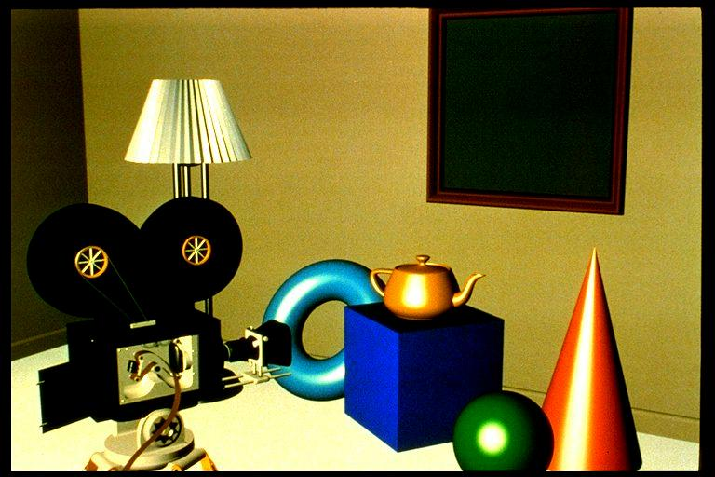
Glossy surfaces
surface seen in a pixel
empirical model
Notes:
Surfaces are usually not smooth, so they reflect light not just in the ideal reflection direction but practically in all possible directions. Physically, we can imagine these rough surfaces as a random collection of ideal mirror microfacets that reflect light according to their random orientation.
As we see not a single microfacet in a pixel, but a large collection of them, we perceive the average radiance reflected by this collection.
Photons may have a single scattering on these microfaces when the average is maximum around the ideal reflection direction of the mean surface. On the other hand, photons may get scattered multiple times, when they “forget” their original direction, so the reflection lobe will be roughly uniform.
Instead of following a probabilistic reasoning, we handle these rough surfaces as a black-box, i.e. empirical model. That is, we describe the behavior of the surface based on everyday experience without any structural analysis. By experience, we say that a rough surface reflects light into all directions, but more light is reflected into the neighborhood of the ideal reflection direction.

Slide 37






Notation for directions
surface point
surface normal
view dir
light dir
halfway between view and light dirs
deviation from ideal case

Slide 38
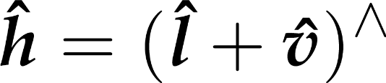







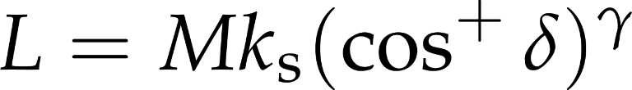

Phong-Blinn model
halfway vector
a function with maximum at
Notes:
Phong-Blinn is an empirical BRDF model. Glossy surfaces reflect more light around the "ideal reflection direction", i.e. the light direction reflected over the surface normal. The more the view direction deviates from this ideal case, the less the reflection should be. We compute the halfway vector h between the view and light directions. The angle between the normal and h is delta. The higher delta is, the further we are from the ideal reflection case. Thus, the reflected radiance should be less. A cosine function of delta achieves this. If we introduce an exponent gamma, we can control how fast the radiance falls off for direction further away from the ideal case. The faster the fall-off, the more concentrated the reflected light is.
In case of directional illumination, the reflections of the light appear as glossy highlights. Higher gamma means smaller, less smeared highlights. The factor ks can be used to control how bright the highlights are. Typically, when increasing gamma, you also want to increase ks. Both gamma and ks are parameters you can choose relatively freely. gamma is often called "shininess", and ks is the "specular color", as its values may be different for the red, green, and blue wavelengths.

Slide 39
Phong-Blinn reflection model
!
from shaded point towards camera, unit length
vec3 shade(
vec3 normal, vec3 lightDir, vec3 viewDir,
vec3 powerDensity, vec3 materialColor, vec3 specularColor, float shininess) {
float cosa = clamp( dot(lightDir, normal), 0, 1);
vec3 halfway = normalize(viewDir + lightDir);
float cosDelta = clamp(dot(halfway, normal), 0, 1);
return
powerDensity * materialColor * cosa
+ powerDensity * specularColor * pow(cosDelta, shininess);
}
material parameters

Slide 40
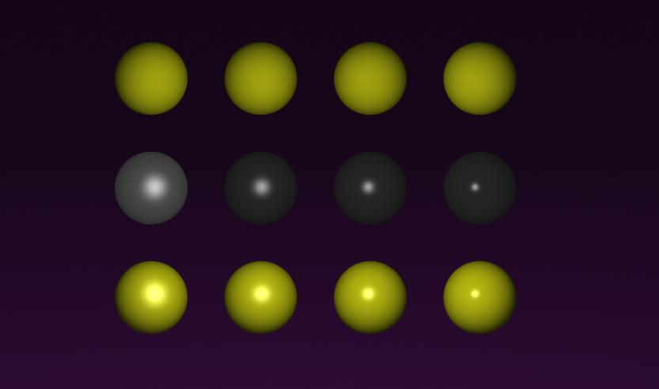
Diffuse + Phong-Blinn
diffuse
Phong-Blinn
diffuse +
Phong-Blinn
γ =
5 10 20 50
Notes:
Combining diffuse and glossy reflections gives us plastic-like or metal-like surfaces. For plastics, the highlight color is white (ks is the same for all wavelengths), for metals, it is proportional to the diffuse color kd.

Slide 41


Phong-Blinn problem

Slide 42

Phong-Blinn problem

Slide 43


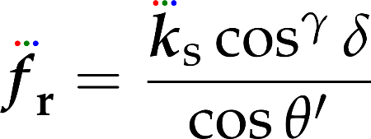
What is the BRDF here?
Phong-Blinn formula
shading equation
therefore the BRDF is
symmetric
non-symmetric

Slide 44
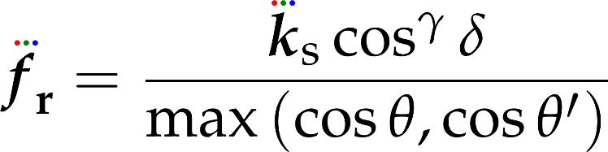

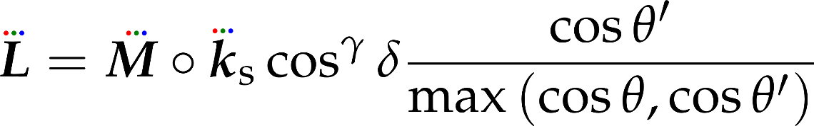

Symmetric version
max-Blinn BRDF

Slide 45
Maximum Blinn reflection model
!
vec3 shade(
vec3 normal, vec3 lightDir, vec3 viewDir,
vec3 powerDensity, vec3 materialColor, vec3 specularColor, float shininess) {
float cosa = clamp( dot(lightDir, normal), 0, 1);
float cosb = clamp(dot(viewDir, normal), 0, 1);
vec3 halfway = normalize(viewDir + lightDir);
float cosDelta = clamp(dot(halfway, normal), 0, 1);
return
powerDensity * materialColor * cosa
+ powerDensity * specularColor * pow(cosDelta, shininess)
* cosa / max(cosb, cosa);
}

Slide 46
Procedural noise gradient (GLSL)
.
vec3 noiseGrad(vec3 r) {
vec3 s = vec3(7502, 22777, 4767);
vec3 f = vec3(0.0, 0.0, 0.0);
for(int i=0; i<16; i++) {
f += cos( dot(s - vec3(32768, 32768, 32768), r*40.0)
/ 65536.0) * (s - vec3(32768, 32768, 32768)) * 40.0;
s = mod(s, 32768.0) * 2.0 + floor(s / 32768.0);
}
return f / 65536.0;
}

Slide 47
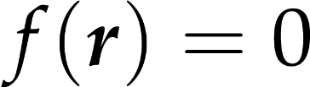
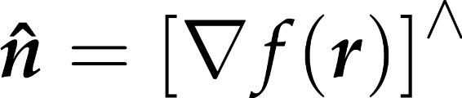
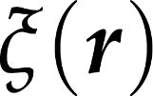
Procedural normal mapping
!
surface equation
surface normal formula
noise function
perturbed surface equation
thus: just add gradient-of-noise, evaluated at worldPosition.xyz, to original normal, then normalize
multiply noise gradient function input and output with appropriate factors to tune

